Slide 1
CPI Mapping Techniques
Bangalore, Feb-2021, Naresh Udaya Kumar

Slide 2
Table of Contents
1
Recap of Day 2
2
Standard Functions
3
Custom Function in mapping
4
Mapping Functions/Types (XSLT & Graphical)
Events and Local Sub-processes
5

Slide 3
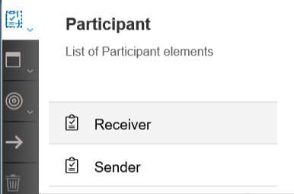
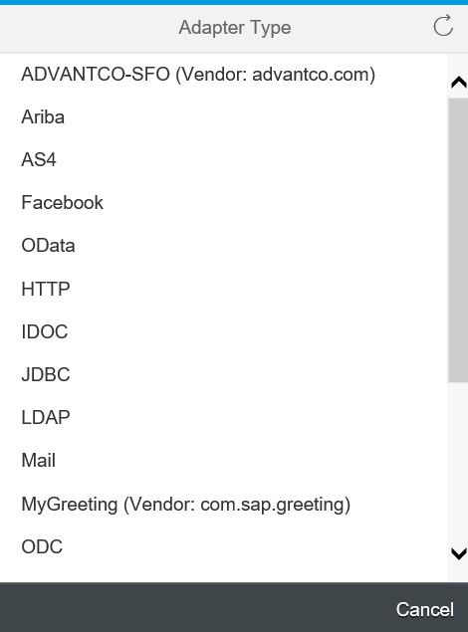
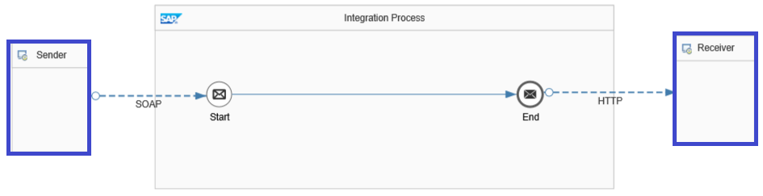
1.Standard Functions: 1.1 Participants and Adapters
No SLD (System Landscape Directory) available in CPI
Sender/Receiver can be added directly from the pallet
Options to select the adapters for sender and receiver appears when we connect adapter with start, end, send events.

Slide 4
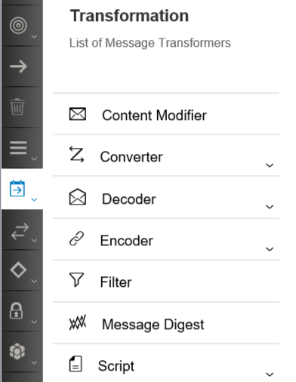
1.2 Transformation
Content Modifier: You use the content modifier step to modify the content of incoming message by providing additional information in the header or body of the message.
Converters: It allows XML to JSON, JSON to XML, XML to CSV and CSV to XML conversion.
Decoder: You use this task to decode the message received over the network to retrieve original data.
Encoder: You use this task to encode messages using an encoding scheme (Base64, GZIP Compress, ZIP Compress and MIME Multipart Encode) to secure any sensitive message content during transfer over the network.
Filter: You use Filter to extract information from an incoming message. In other words, you filter out parts of the message that you do not want and extract only the data that you want.
Message Digest: It transforms a message into a canonical XML document.
Script: You use this task to execute custom Java script or Groovy script for message processing.

Slide 5
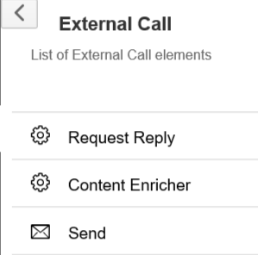
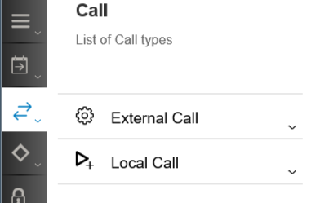
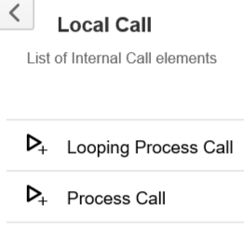
1.3 Call
Request Reply flow step sends the request message, waits for the reply message, then processes the reply.
Content Enricher accesses an external data source in order to augment a message with missing information.
Send step makes a service call to a receiver system for scenarios and adapters where no reply is expected.
Looping Process Call is used to execute local integration process multiple times depending on some condition and maximum Numbers of allowed Iterations.
Process Call is used to execute local integration process once without any condition or maximum Numbers of iteration option.

Slide 6
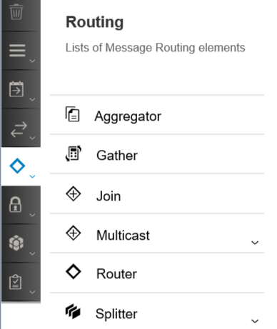
1.4 Routing
Aggregator: It bundles the incoming messages; it is N:1 vice versa to Splitter, that means it is used to combine multiple incoming messages into a single message.
Gather: The Gather step enables you to merge messages from one or more than one route in an integration process.
Join: Join helps to connect multiple process branches to one. Join followed by Gather can help to gather and merger messages from multiple process route.
Multicast: This process step is used to send the message to more than one receiver (flow) either parallel or sequential. This is unconditional routing.
Router: This process step is used to determine the receivers to deliver the messages. We can have routing conditions and all branches should have the same type of condition either xml or non-xml, we can make one of the branch as default.
Splitter: Break down a message into multiple individual messages.

Slide 7
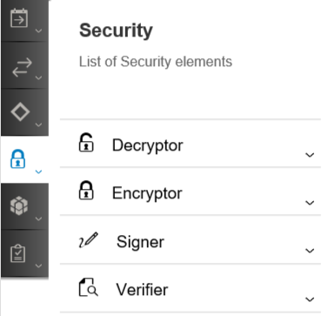
1.5 Security
Decryptor: CPI allows you to Decrypt the PGP and PKCS7 encrypted messages.
Encryptor: CPI allows you to Encrypt messages with PGP and PKCS7 keys.
Signer: Outgoing messages may be singed in CPI system. Receiver system can validate the sender system.
Verifier: Verifier step is used for check if CPI has received the message from known valid sender system.

Slide 8
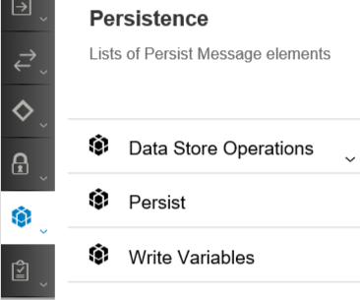
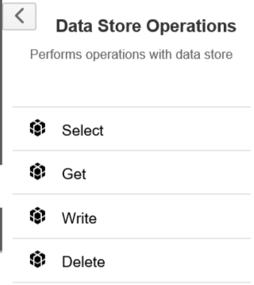
1.6 Persistence
Persist –At runtime, information such as message GUID, timestamp, and payload are stored for the messages at the persistence process steps. The message storage feature is useful for auditing purposes and analyse it at a later point in time.
Write Variables - CPI allows you to temporarily persists name-value pairs.
Data Store Operations - helps to store complete message in the Datastore.
Operation | Used to ...
Select | Fetch messages in bulk from the data store.
Get | Fetch a specific message from the data store.
Write | Store the messages temporarily in the data store. If you use a Write operation, you can store the messages in the data store by configuring the data store name and a unique Entry ID.
Delete | Trigger the deletion of messages in the data store.

Slide 9
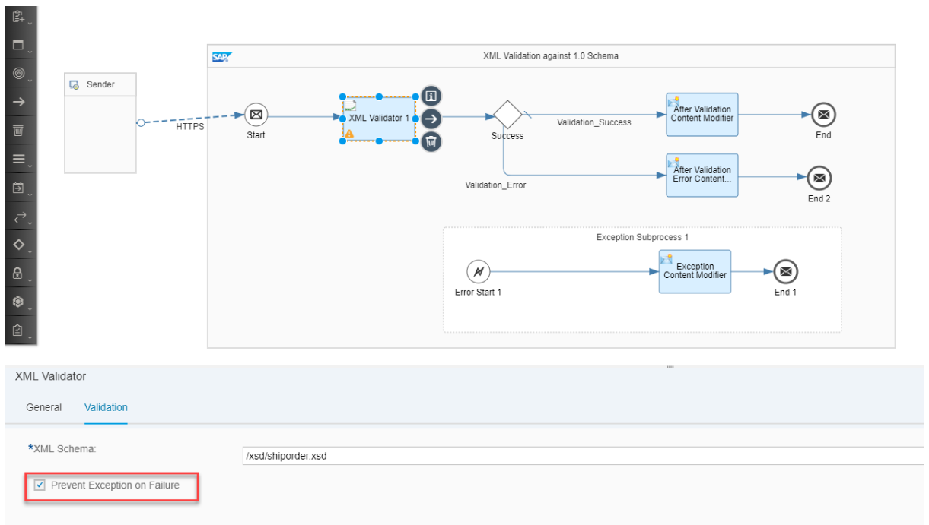
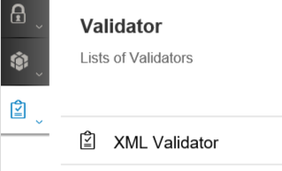
1.7 Validator
SAP Cloud Platform Integration offers capabilities to validate the XML payload against a given XML Schema.
Following are the features of XMLValidator that helps you to validate XML payloads.
Stop Message Processing on Validation Failure(Uncheck Prevent Exception on Failure)
Continue Message Processing During Validation Failure (Check Prevent Exception on Failure)

Slide 10
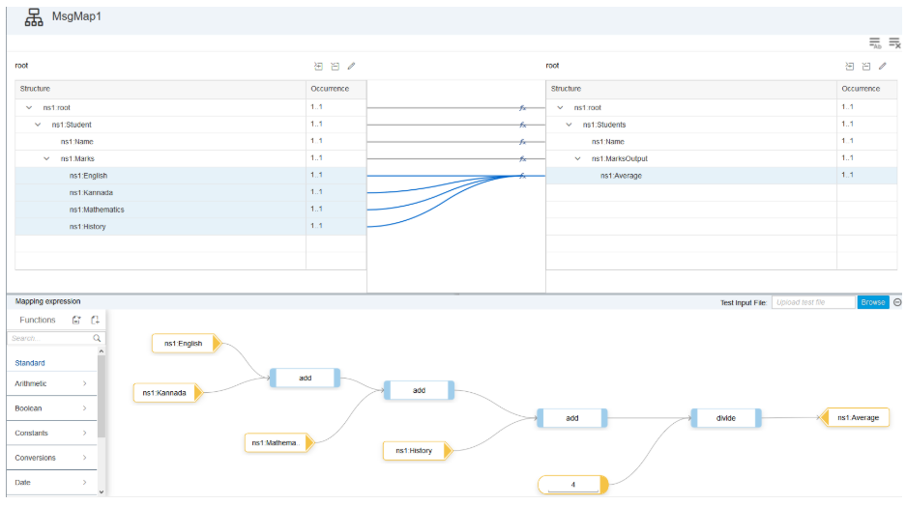
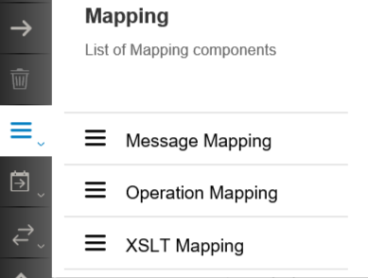
2. Custom Functions in Mapping
Message Mapping

Slide 11
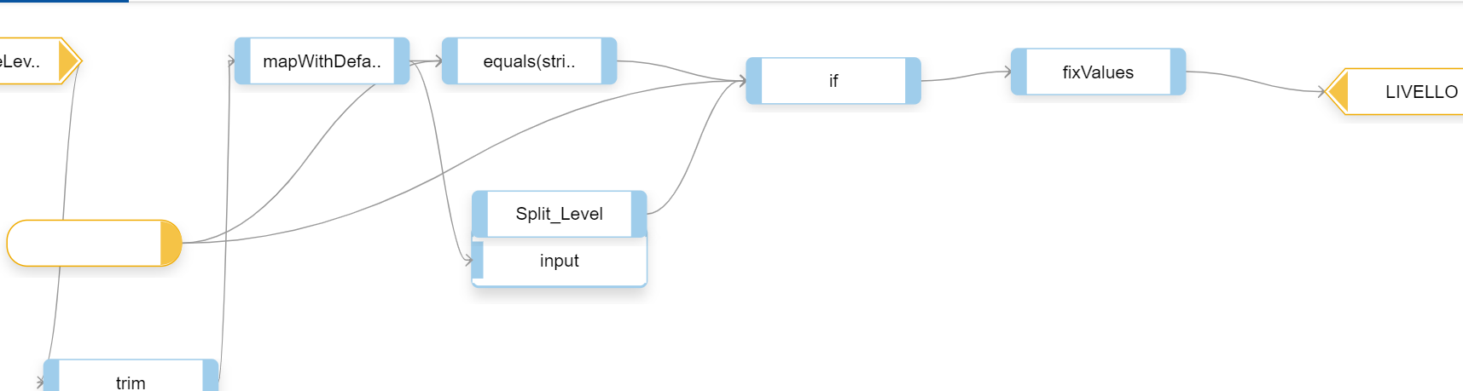
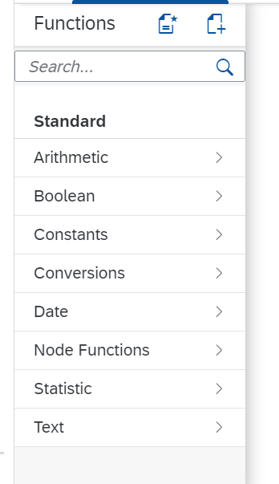
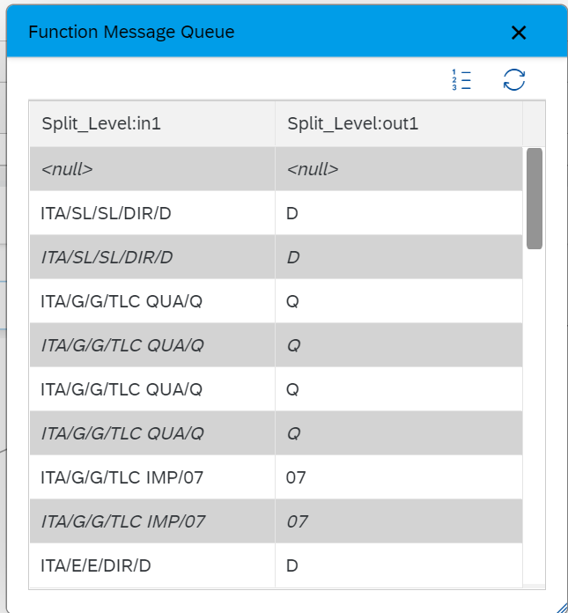
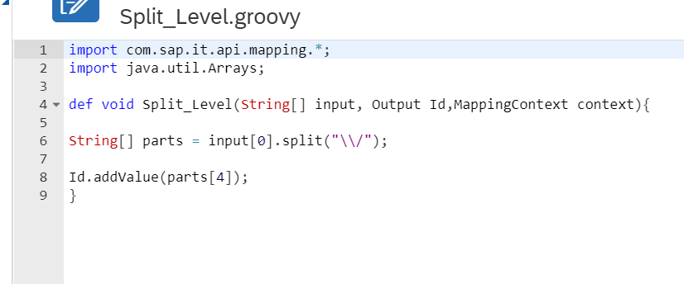
2.1 SPLIT
Standard Functions
Custom Function- Split
Input-Output

Slide 12
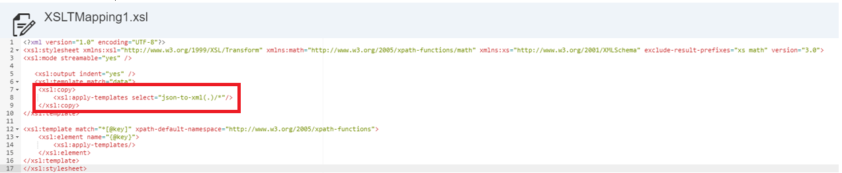
3. Mapping Functions/Types( XSLT and Graphical)
XSLT - XSL Transformations, the purpose of this is for transformation of XML documents into other formats like XML, XHTML and etc.
XPATH - XSLT uses XPATH to find information in an XML document. XPATH is used to navigate through elements and attributes in XML documents.
XSLT Mapping
This scenario explains how to convert JSON into XML using XSLT 3.0 function in XSLT Mapping step.

Slide 13
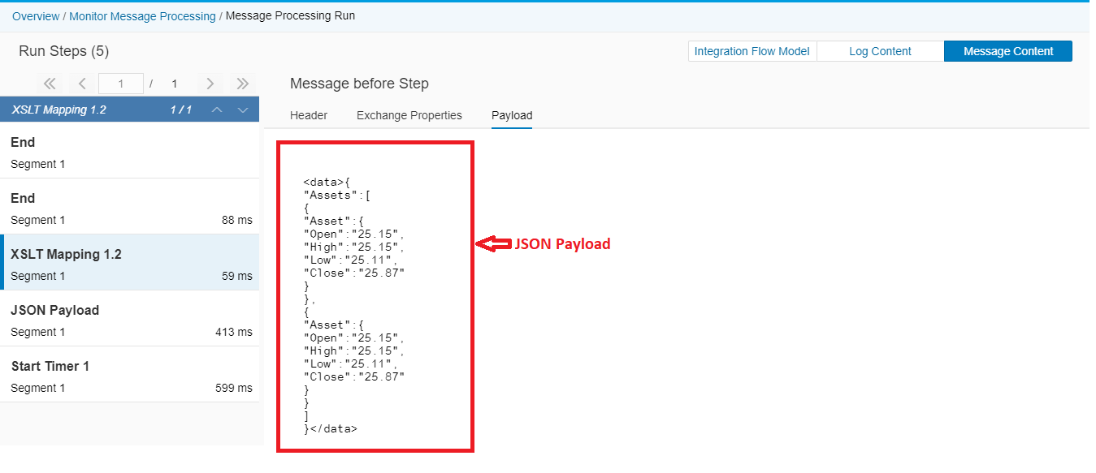
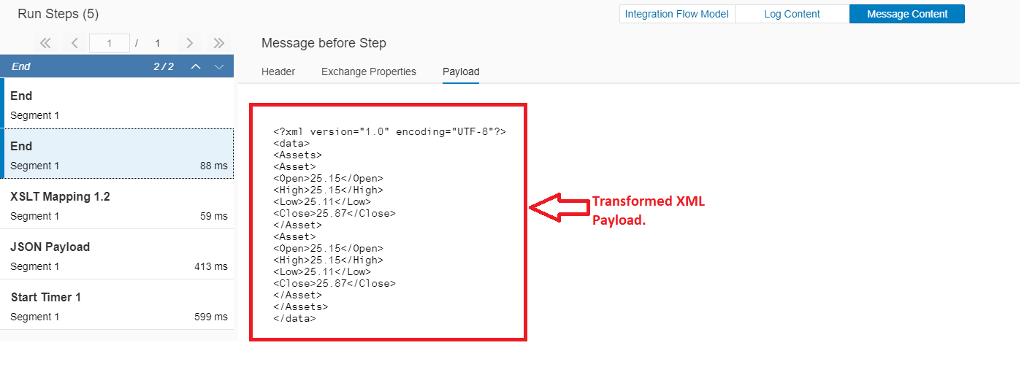
In trace mode, we can see how this is working:
INPUT
OUTPUT

Slide 14
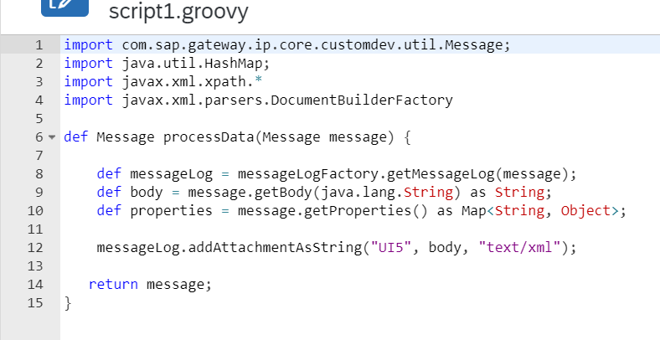
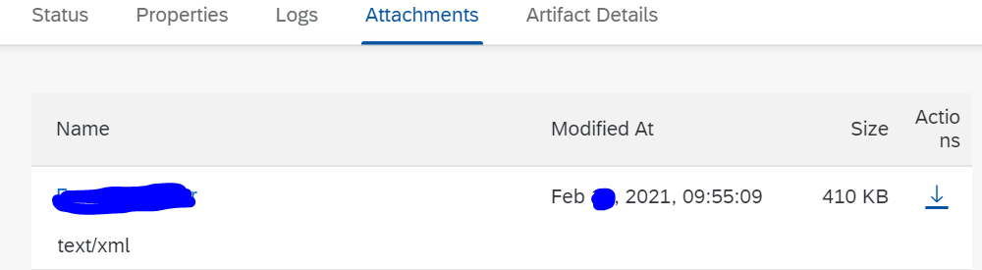
Groovy script
This groovy script is storing payload
Saved in attachments in Monitoring

Slide 15
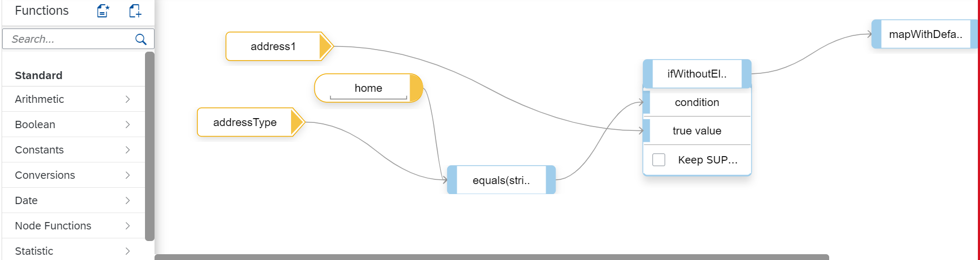
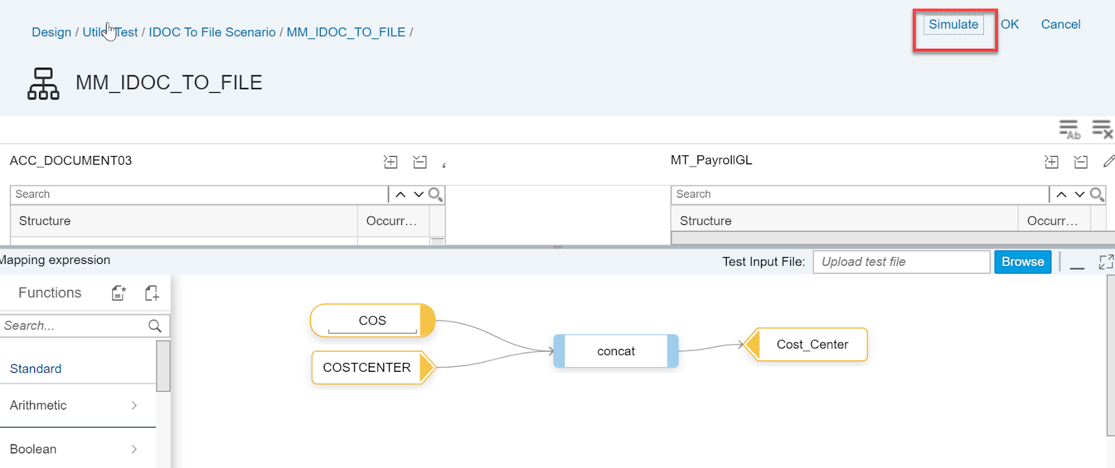
Graphical :
Testing Functions:
- Simulate
- Display Queue

Slide 16
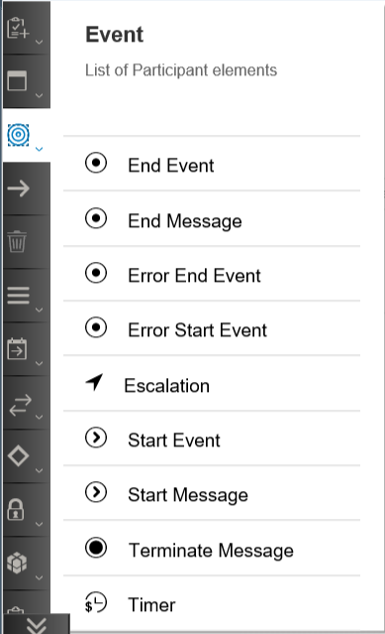
4.1 Events & Local Sub-processes:
Start Message -SAP Cloud Platform Integration receives a message from a Sender
End Message - SAP Cloud Platform Integration sends a message to a Receiver.
Error Start Event and Error End Event- Can be used only within an exception sub-process.
Timer start is especially useful in scenarios where you have go and pull data from systems or have to trigger Web services at specified time/ intervals.
Terminate Message – this is useful if you want to stop further processing of a message.
Start Event – Start of Local Integration process
End Event – End of local Integration process
Escalation - The Escalation Event does not abort the integration flow processing as a whole but only throws the Escalation Event.

Slide 17
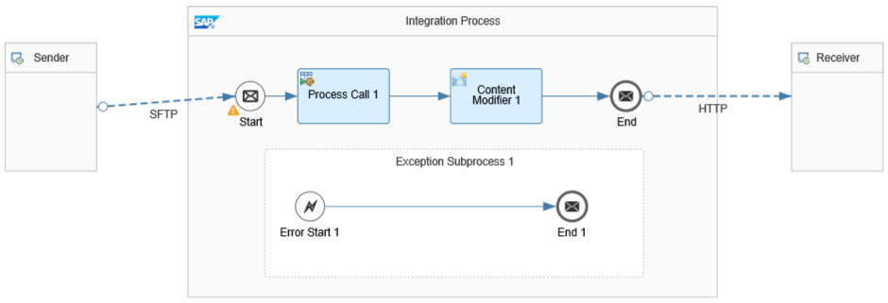
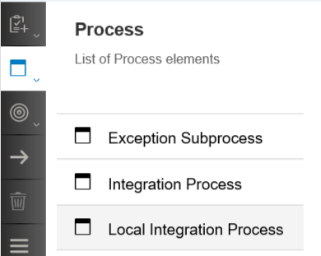
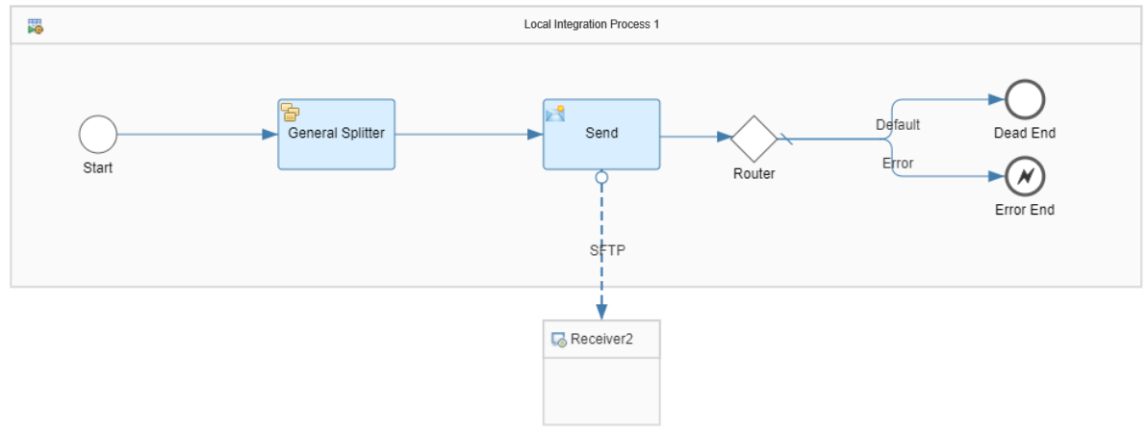
4.2 Process
Exception Subprocess :- Triggered automatically when there is exception in the Integration process. It is not connected with any of the process.
Local Integration Process :– It is the sub-process for specific task and that can be called from the Integration Process using Process call.

Slide 18

Questions?

